Slide 1

Cluster Analysis of Risk Tags
By Akhil Devarasetty

Slide 2

Data Preparation
Isolated data to only consider 5 risk tags based on frequency
exploitation
bad_contract
external_dependencies
centralized_risk_medium
is_airdrop_scam
Switched True and False to 1 and 0

Slide 3
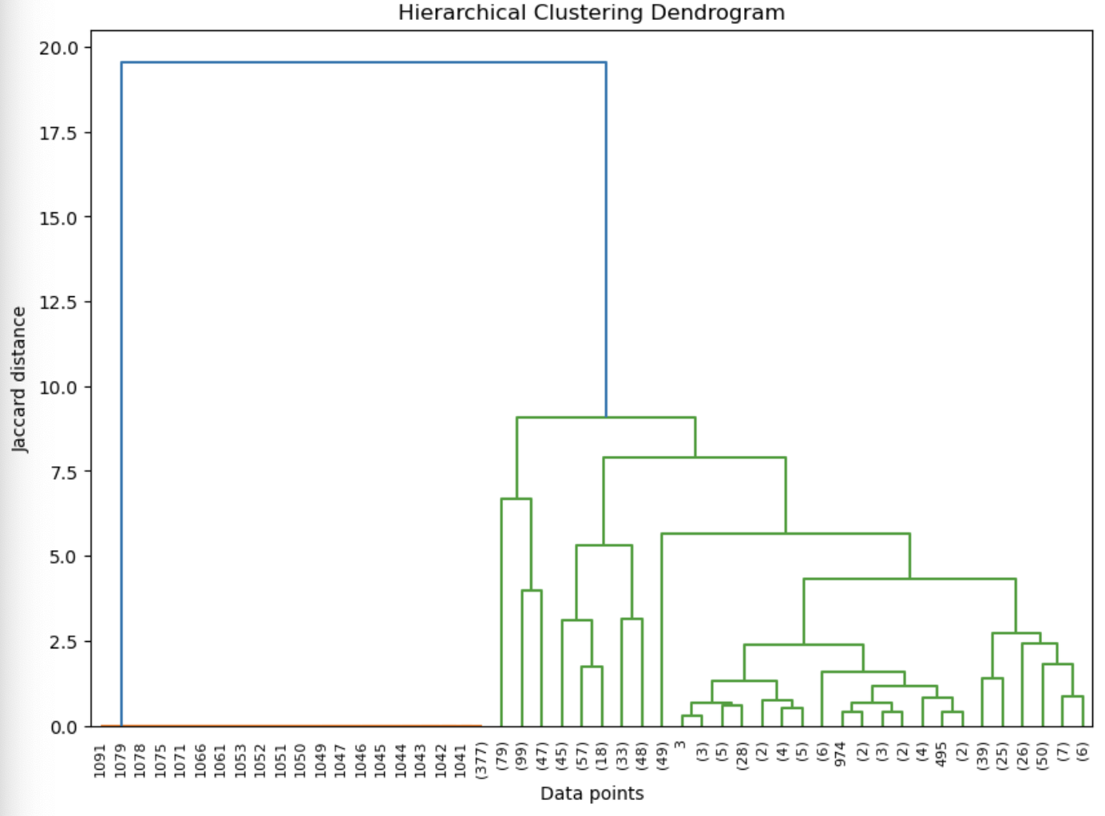
Cluster Dendrogram
Created using the Jaccard distance to create a linkage matrix
Truncated to 50 points due to large size
2 main clusters: blue and green
Green has many smaller clusters
Blue has a very large distance from green
10 marks the point where blue can be separated from green

Slide 4
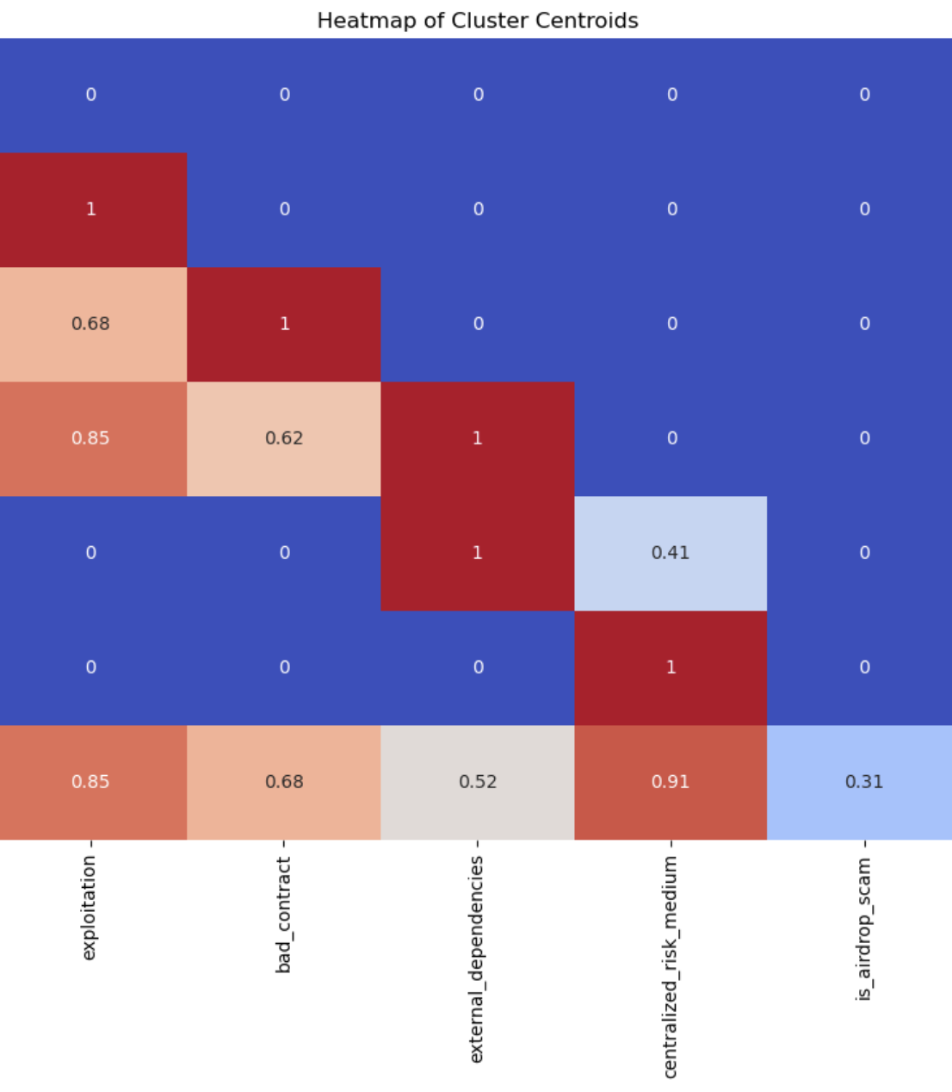
Cluster Heatmap
7 Clusters according to the heatmap
Cluster 1 represents all the risk tags not used
Cluster 2 had a high number of points with bad_contract and exploitation
Cluster 3 was similar to 2 but also had a lot of bad contracts
Cluster 4 was similar to 3 but also had external dependencies
Cluster 5 was mainly external_dependencies but had a bit of medium centralized risks
Cluster 6 was entirely made of points with medium centralized risk tags
Cluster 7 was a mix of all featured risk tags

Slide 5

Meaning behind results
There is a large mount of exploitation occurring within the Web3 landscape
Most methods mentioned within tags are used to exploit
Finding ways to reduce methods of exploitation will naturally reduce the number of audits with bad results

Slide 6
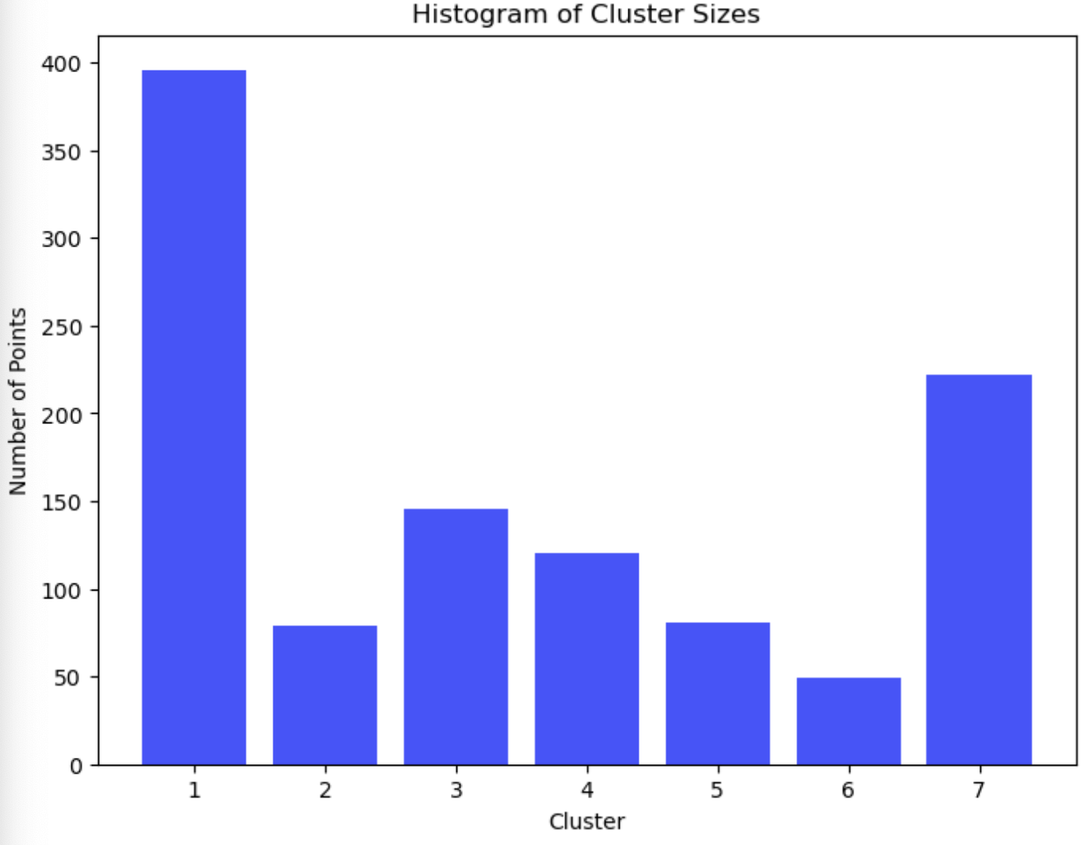
Further Steps
According to the size of each cluster, many audits are a mix of each risk tag
More clustering may be necessary to determine specific relationships between tags
Adding more risk tags to the clustering may change the size of each cluster and add different cluster on top
Clustering further will allow us to see what types of problems would be affected most (If everything exploit was due to fake tokens, then fixing those tokens will fix most of the problems)

